Slide 1
AWStream: Adaptive Wide-Area Streaming Analytics
Ben Zhang, Xin Jin, Sylvia Ratnasamy
John Wawrzynek, Edward A. Lee
Presented by Radhika Mittal (not a co-author)

Slide 2
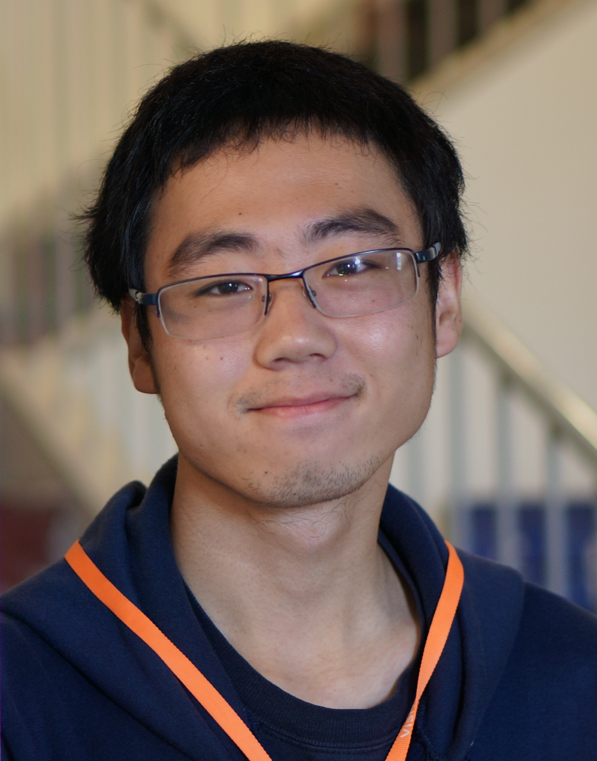
Ben Zhang

Slide 3



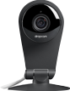
Wide-Area Streaming Analytics
Demand
Huge data generated at the edge
Resource
Scarce and varying WAN bandwidth
Notes:
Wide-area streaming analytics refers to applications in which data generated on end devices is transported across the wide-area for processing. Examples include machine logs processing, mobile applications and IoT applications that use the cloud.
(click) These applications generate a large amount of data, and (click) challenge the underlying resources, the scarce and varying WAN bandwidth

Slide 4
Demand: Huge Data at the Edge
Machine logs, 25 TB daily at Facebook (2009)
Electrical grid monitoring, 1.4 million data points per second [Andersen and Culler, FAST ‘16]
Video surveillance, 3 mbps per camera [Amerasinghe, 2009]
. . . Dropcam, a WiFi video-streaming camera and associated cloud backend service for storing and watching the resulting video. Dropcam has the fewest clients (2,940) . . .. Yet, each client uses roughly 2.8 GB a week and uploads nearly 19 times more than they download, implying that Dropcam users do not often watch what they record. [Biswas, SIGCOMM ‘15]
Notes:
On the demand side, early in 2009, Facebook has reported more than 25TB machine logs generated every day
A recent work focusing on electrical grid monitoring reported 1.4 million data points per second
And for video surveillance, each camera requires roughly 3 mpbs bandwidth
We quote a measurement study from Meraki that is published in SIGCOMM'15: Dropcam has the fewest clients, but it generates large upload traffic.

Slide 5
Resource: Scarce and Varying WAN Bandwidth
Less than 25%
Bandwidth variations throughout the day between Amazon EC2 sites. Similar scarcity and variation for wireless networks, broadband access networks and cellular networks.
Notes:
On the resource side, the WAN bandwidth is scarce and varying. (click) We conducted a day-long measurement across two EC2 sites and we can see that the achievable bandwidth fluctuates greatly. (click) It even drops to 25% of the maximum. Similar variations have also been reported for wireless networks, broadband, and cellular networks.

Slide 6
What happens when bandwidth becomes insufficient?
TCP ensures data delivery, but hurts latency
UDP sends fast, suffering uncontrolled packet loss
Manual policies (developer heuristics) are sub-optimal
JetStream [Rabkin et al., NSDI 14] uses manual policy
“if bandwidth is insufficient, switch to sending images at 75% fidelity, then 50% if still not enough”
Application-specific optimizations don’t generalize
(more on the next slide)
Notes:
1. For applications, what happens when bandwidth becomes insufficient? (click through each bullet point)
2. Applications built on top of TCP will ensure complete data delivery but backlogged data hurts latency.
3. On the otherhand, applications built on top of UDP will send data as fast as possible, but the network drops packet, leading to uncontrolled packet loss
4. We could devise some manual policy that changes the application behavior, for example, in JetStream, a work from Princeton in NSDI 14, you can specify adaptation policies such as “if bandwidth is insufficient, switch to sending images at 75% fidelity, then 50% if still not enough”. However, these policies are often developer heuristics, leading to sub-optimal performance.
5. We could optimize one application for optimal performance, but as we will show, application-specific optimization do not generalize.

Slide 7
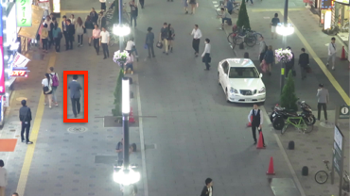
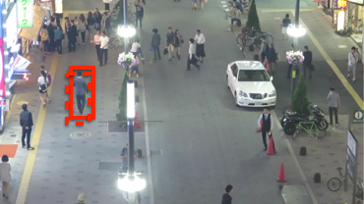
Application-specific optimizations don’t generalize
For a surveillance application that detects pedestrians on a busy street
Positive if intersection over union (IOU) larger than 0.5.
t=0s, small target in far-field views
IOU=0.2
IOU=0.5
IOU=0.8
t=1s, small difference
Notes:
1. Let’s take a surveillance application as an example. It detects pedestrians on the street.
2. The left-top figure shows that at t=0, we detect a small target in the camera's view
3. The left-bottom figure shows that at t=1, because targets move slow, there is only a small difference
4. (click) We define a detection is positive if intersection over union is larger than 0.5, here are some illustrations of IOUs
5. This means that in this application, we can skip frames when performing detection because the frame differences are small
6. And if we measure the effect (jump to next slide)

Slide 8
Application-specific optimizations don’t generalize
For a surveillance application that detects pedestrians on a busy street
t=0s, small target in far-field views
t=1s, small difference
Notes:
(show first figure) We can see that changing frame rate, from 30 fps to 2 fps, is effective in reducing bandwidth requirement while maintaining a high accuracy
However, as the resolution is tuned, from 1080p to 360p, we can see that accuracy deteriorates fast because targets are small
Now we have an optimized strategy for this application. Unfortunately, it doesn't necessarily work for other object detection applications? (next slides)

Slide 9
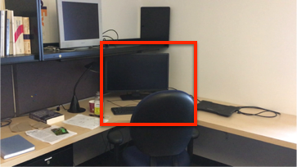
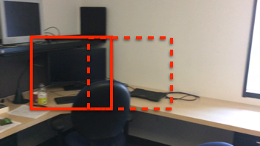
Application-specific optimizations don’t generalize
For an application that detects objects on a mobile phone
t=0s, nearby and large targets
t=1s, large difference due to camera movement
Notes:
1. For an application that detects objects on a mobile phone, like in augmented reality applications, now targets become large and the camera moves
2. We can see that adapting frame rate is bad in this application because the difference across frames is large
3. Instead, adapting resolution works better because targets are large

Slide 10
What happens when bandwidth becomes insufficient?
TCP ensures data delivery, but hurts latency
UDP sends fast, suffering uncontrolled packet loss
Manual policies (developer heuristics) are sub-optimal
JetStream [Rabkin et al., NSDI 14] uses manual policy
“if bandwidth is insufficient, switch to sending images at 75% fidelity, then 50% if still not enough”
Application-specific optimizations don’t generalize
Adaptation often requires expertise and manual work to explore multidimensional adaptation for each application
Notes:
So this list summarizes how the underlyign scheme affects different application behaviors, and it basically boils down to this trade-off space between fidelity and freshness.

Slide 11
Fidelity vs. Freshness
Notes:
Here the horizontal axis is data freshness, measured in latency, but reversed, the more to the right, the better
The vertical axis is data fidelity, measured as application accuracy ranging from 0 to 1
The options we have discussed early are basically design points in this trade-off space.
TCP is on the upper-left corner; UDP on the bottom-right corner;
Manual policy explores the trade-off, but it is suboptimal
For application-specific optimization, when the application changes, it also becomes suboptimal
(next slides)

Slide 12
Fidelity vs. Freshness
Applications must be adaptive.
Adaptation policies must be,
precise
automatically generated
for each application
Pareto-optimal Profile: maximizing application accuracy while satisfying bandwidth requirement (avoid congestion)
Notes:
In this talk, we will show you our work AWStream that achieves both freshness and fidelity.
This comes from our observation that application must be adaptive, and adaptation policies must be precise, automatically generated, for each application. (click) and these policies are what we call pareto-optimal profile that maximizes application accuracy while satisfying bandwidth requirement, avoiding congestion

Slide 13
AWStream Overview
Systematic and quantitative adaptation
New programming abstractions to express adaptation
Automatic data-driven profiling
Runtime adaptation balancing freshness and fidelity
Profile
Develop
Profiling
Runtime
Training
Data
var | bw | acc
1920 | 10.7 | 100
1280 | 8.3 | 91
Application
Offline Profiling
Runtime Adaptation
Accuracy
Function
maybe APIs
Online Profiling
Resource Allocation
Online
Data
Notes:
At its core, AWStream proposes systematic and quantitative adaptation, it has three key parts:
New programming abstraction to express adaptation
Automatic data-driven profiling
Runtime adaptation
(click to show)
This figure shows the three key parts and how developers can use AWStream. We then discuss each part, developer APIs, profiling, runtime, in turn.

Slide 14
(1) Streaming Operators and APIs
Data Stream
Operator
Data Stream
{x1, x2, x3, x4, … }
map(f)
{ f(x1), f(x2), f(x3), f(x4), … }
{x1, x2, x3, x4, … }
window(2, f)
{ f(x1, x2), f(x3, x4), … }
{x1, x2, x3, x4, … }
maybe(k, f)
{ f(x1, k1), f(x2, k2), f(x3, k3), f(x4, k4)… }
k is a tunable knob
Notes:
First, let’s talk about the stream processing APIs.
The basic building blocks are operators that transforms data streams into new data streams. Examples of such operators are map (click to show) that applies to each element and window (click to show) that groups stream elements. These are examples of normal operators (click to show).
We propose maybe operators (click to show) that is parameterized by k, a tunable knob (click to show annotation, and hide). This maybe operator allows the application developers to provide hints to their system as to what aspect of the application can be adapted to support a smaller bandwidth. (click to show other operators) On top of the basic maybe operator, we can build a set of operators that are customized for different operations.

Slide 15
(1) maybe APIs in use
let quantized = vec![1, 2, 3, 4].into_stream()
.maybe(vec![2, 4], |k, val| val / k)
.collect();
No
Adaptation
{1, 2, 3, 4, …}
{1, 2, 3, 4, …}
maybe quantize
k = 2
{0, 1, 1, 2, …}
k = 4
{0, 0, 0, 1, …}
let app = Camera::new((1920, 1080), 30)
.maybe_downsample(vec![(1600, 900), (1280, 720)])
.maybe_skip(vec![2, 5])
.map(|frame| pedestrian_detect(frame))
.compose();
Notes:
Let’s see an example of how maybe can be used. This code snippet shows a quantized data stream. (click to show figure). The input is {1, 2, 3, 4, …} and after the operator, it can become {1, 2, 3, 4, ..} if no adaptation is applied, or {0, 1, 1, 2, …} if k = 2, or {0, 0, 0, 1, …} if k = 4.
With such a maybe APIs, our original pedestrian detection application can be expressed as following (click to show). It has two maybe operations: downsample (to reduce the resolution) and skip frames (that reduces the no. of frames per second) (click to highlight).

Slide 16
(2) Data-driven profiling
let app = Camera::new((1920, 1080), 30)
.maybe_downsample(vec![(1600, 900), (1280, 720)])
.maybe_skip(vec![2, 5])
.map(|frame| pedestrian_detect(frame))
.compose();
Training
Data
downsample | skip | bandwidth | accuracy
(1920, 1080) | 0 | 10.7 | 1.0
(1600, 900) | 0 | 8.3 | 0.88
(1280, 720) | 0 | 6.3 | 0.87
(1920, 1080) | 2 | 9.3 | 0.90
… | … | …. | …
Accuracy
Function
Notes:
The next step after application is developed is to profile. We take a data driven approach. By feeding in training data and providing an accuracy measurement (click to show), we learn the effect of each degradation operations (click to show), as shown by this table. Each row depicts a particular configuration of the application, depending on how its “maybe” knob is set.

Slide 17
(2) Profile: Pareto-optimal Strategy
1
configuration | bandwidth | accuracy
c1 | 10.7 | 1.0
c2 | 8.3 | 0.88
c3 | 6.3 | 0.87
c4 | 9.3 | 0.90
… | …. | …
Accuracy
0
0
1
Bandwidth (normalized)
the set of better configuration c’
Notes:
Now the goal of the profiling is to learn a Pareto-optimal strategy. We illustrate it with this figure. The x-axis is bandwidth, normalized. The y axis is accuracy. And we measure the effect of each configuration.
(click to animate these points, stop at the step when many points appear at once).
What we are looking for is Pareto-optimal configurations. Mathematically, it is defined as this formula, that says, the set of better configurations is an empty set; a better configuration is one that requires less bandwidth but offers higher accuracy. Visually, they are the configurations marked red dots in this figure.

Slide 18
(3) Runtime Adaptation
data
Application
Stream
Source
Socket
Analytics
Client (Edge)
Server
Notes:
Once we have learned the profile, we apply it at runtime. The original applications directly transmit data from source to the server that performs analytics.

Slide 19
(3) Runtime Adaptation
data
Application
control
System
Stream
Source
Queue
maybe
Socket
Receiver
Analytics
Adaptation Controller (AC)
Client (Edge)
Server
Startup
Degrade
Steady
Probe
Multiplicative
Decrease
Additive
Increase
Notes:
We augment it with control flows and system components that perform a feedback control. The adaptation controller monitors local queue length and congestion signals from the receiver, it then controls the level of adaptation using the maybe operators to better match the available bandwidth.
The adaptation algorithm, shown as a state-machine, is similar to TCP adaptation. (click to show) We have four states: startup,degrade, steady, and probe. (click) The adapt phase is similar to multiplicative decrease while the probe is similar to additive increase. What is unique in AWStream is that we have the profile that characterizes application performance. When adapting, AWStream pinpoints the right configuration.

Slide 20
(3) Probing at Runtime
Startup
Degrade
Steady
Probe
1
These configurations are discrete
Without probing, applications can jump to the next configuration that demands too much bandwidth. They end up oscillate between configurations.
Probing (with dummy traffic) stabilizes adaptation.
Oscillate
Accuracy
Available
Bandwidth
0
0
1
Bandwidth (normalized)
Notes:
Before we move on, we quickly discuss the importance of the probe phase.
Recall the learned Pareto-optimal profile (click). These configurations are discrete (click).
And suppose the available bandwidth (click) is between two configurations.
Without probing, applications jump to next configuration that demands too much bandwidth. They end up oscillate between configurations.
Probing allows us to ensure that there is enough bandwidth to use the next configuration.

Slide 21
Applications
Quantization is a parameter exposed from the video encoder (H.264)
Notes:
We have built three applications, augmented reality, pedestrian detection and a log analysis app that extracts top-k (click through to show all applications)
For the first two, in addition to changing resolutions and frame rates, we also change quantization level, a parameter exposed by the video encoder.

Slide 22
Applications
Notes:
While for top-K log analysis some application specific paraemter knobs N and T are used.

Slide 23
Adaptation in Top-K
File Access Logs
Group into
(file: count)
Take top-3
with head(3)
Filter with
threshold 2
Global Top-K after merge
Notes:
For Top-K, we illustrate the two maybe operators with a simple example that calculates the top-1 accessed file.
(click through the animations, then it goes to the next slide)
First, each client gathers the file access logs
It then group them into a key value pair, where the key is the file name, and the v
alue is the count of occurrence.
It then takes the local top N, here N is 3; and filters with a threshold, which is 2.
The server then merges data from multiple clients and calculates the global top 1.

Slide 24
Adaptation in Top-K
f2 is not Top-1 in either client, and could have been purged with different parameter N or T
Notes:
As we can see, f2 is the global top 1, but it is not the top-1 in either client. It could have been purged if we have different N or T. This shows how local maybe operators affect Top-K accuracy. This shows how other applications beyond just video analytics can also be adapted using AWStream.

Slide 25
Evaluations
Can AWStream generate accurate profiles across multiple dimensions?
Can AWStream profile efficiently and support online profiling?
Can AWStream runtime improve data freshness and fidelity when facing insufficient bandwidth?
Can we use the profiles to guide bandwidth allocations among multiple applications?
Notes:
We show our evaluation to answer the following questions
(read through)

Slide 26
Evaluations
Can AWStream generate accurate profiles across multiple dimensions?
Can AWStream profile efficiently and support online profiling?
Can AWStream runtime improve data freshness and fidelity when facing insufficient bandwidth?
Can we use the profiles to guide bandwidth allocations among multiple applications?
Notes:
For the interest of time, we focus on generated profiles and runtime evaluation. The rest can be found in the paper.

Slide 27
Profiles across multiple dimensions
Different
Dimensions
Pedestrian Detection
Augmented Reality
Same Dimension
Optimal strategy needs multiple dimensions
For the same application, different dimensions have different impact.
For different applications, the same dimension has different impact.
Notes:
First, we show the generated profiles. The figure here shows bandwidth as the x-axis and accuracy as the y-axis. (click to show points) Each cross dot represents a configuration. We highlight the configurations if we only tune a single dimension, (click to show legend) for example, red lines show the configurations if we only tune resolution. We also show the Pareto-optimal configurations.
We compare pedestrian detection and augment reality side by side.
(click to show bullet points)
From these two figures, we can see that, optimal strategies need a combination of all dimensions. And for the same application, different dimensions have different impact.
Compare these two applications, we see that the same dimension often has different impact, echoing our earlier argument of application-specific optimizations do not generalize.

Slide 28
Profiles are precise
The effect of each dimension is not significantly different.
The profile offers quantified effects of adaptation options.
Notes:
For Top-K, the profile quantifies the impact of N and T, while these dimensions are not as separated as the video anlaytics applications, our profile gives a quantitative measurement to guide adaptation.

Slide 29
Runtime Performance Baselines
Notes:
Next, we show our runtime evaluation. We compare AWStream with a few baselines. (click to read through).
the first one is streaming over TCP, a non-adaptive approach.
The next one is streaming over UDP, that represents RTP/RTSP based video streaming
The next one is JetStream and we use this particular manual policy excerpt from the paper
The next one is JetStream++, a modified version of JetStream that can use our learned profile. It still uses JetStream runtime that does not probe, and will oscillate.
The last baseline is HLS, representing HTTP based adaptive streaming.

Slide 30
TCP catching up
More Traffic shaping
Traffic shaping
Remove shaping
TCP hurts latency
UDP hurts accuracy
Notes:
Our controlled runtime experiment follows JetStream. (click to show throughput figure). We apply traffic shaping at 200s and increase the shaping level at 380s, We remove the shaping at around 440s. The top figure shows the achieved throughput. (click to show two more figures) And we measure application latency and accuracy. (click to show markers for TCP) We can see that TCP which had queued items when bandwidth was scarce,tries to catch up when more bandwidth is available. (click to show TCP latency marker). The latency due to backlogged data is very large, notice the log scale on the latency figure. (click to show UDP marker) UDP on the other hand, has bad accuracy because of data loss.

Slide 31
Manual policy does not have enough adaptation
Notes:
For JetStream, it can balance latency and accuracy better than TCP, it cannot sustain severe bandwidth shaping, because the specifc manual policy and its latency also grows.

Slide 32
Bounded Latency
Policy Oscillation
Notes:
JetStream++ uses our learned profile. While it provides bounded latency, it reacts to bandwidth changes fast and suffer from policy oscillation.

Slide 33
Latency due to buffering
Notes:
For HLS, it is adaptive, but there is a fix high latency due to its chunking behaviour and the use of a large receiver buffer.

Slide 34
Low latency
High accuracy
Notes:
Finally, AWStream achieves low latency and high accuracy at the same time.
(click to next)

Slide 35
Runtime Performance Summary
Notes:
We summarize their performance in this boxplot for a clear comparison.
pause for a sec
Or we combine these two figures, and as we have alluded earlier (click to show figure), AWStream achieves fidelity and freshness at the same time.

Slide 36
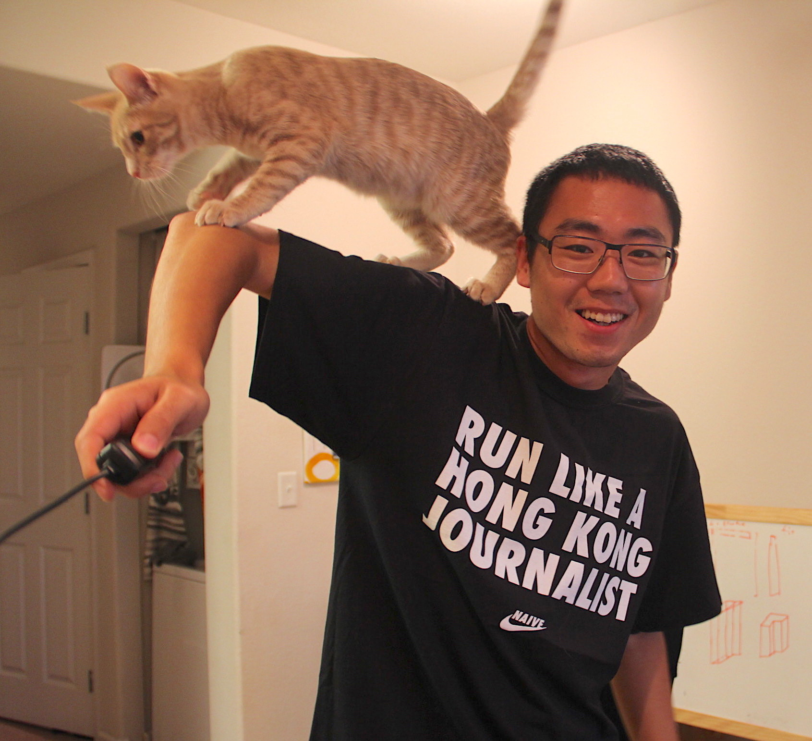
Conclusion
The emerging wide-area streaming analytics
They are becoming pervasive with more IoT applications
They must address scarce and varying WAN bandwidth
We present AWStream.
A systematic and quantitative approach towards adaptation
Novel APIs, automatic profiling, and runtime adaptation
For more questions,
Contact: Ben Zhang, benzh@cs.berkeley.edu
Slides: https://awstream.github.io/talk/talk.pdf
Repository: https://github.com/awstream
Notes:
In this talk, we study the emerging wide-area streaming anlaytics, that are becoming pervasive with more IoT applications. These applications must address the scarce and varying WAN bandwidth. In this talk, we have presented AWStream, which is a systematic and quantitative approach, that includes novel APIs, automatic profiling and runtime adaptation.
For more questions, please contact Ben, blah blah

Slide 37
Applications
Application | Knobs | Accuracy | Dataset
Augmented Reality | Resolution Frame rate Quantization | F1 Score [Rijsbergen, 1979] | iPhone video clips Training: office, 24s Testing: home, 240s
Pedestrian Detection | Resolution Frame rate Quantization | F1 Score | MOT 16 [Milan et al., 2016] Training: MOT 16-04 Testing: MOT 16-03
Log Analysis (Top-K, K=50) | Head(N) Threshold(T) | Kendall’s Tau [Abdi, 2007] | SEC.gov logs Training: 4 days Testing: 16 days
Notes:
This slide is skipped.

Slide 38
Evaluation: Runtime
Baseline | Description
Streaming over TCP | A non-adaptive approach
Streaming over UDP | A non-adaptive approach, representing RTP/UDP/RTSP video streaming
JetStream [Rabkin et al., 2014] | Manual Policy: “if bandwidth is insufficient, switch to sending images at 75% fidelity, then 50% if there still isn’t enough bandwidth. Beyond that point, reduce the frame rate, but keep the image fidelity.”
JetStream++ | Uses adaptation policy generated by AWStream. JetStream runtime does not probe (hence may oscillate between policies).
HLS [Pantos and May, 2016] | HTTP Live Streaming represents popular adaptive video streaming techniques; used for Periscope video stream [Wang et al., 2016].

Slide 39
(3) Runtime Adaptation
data
Application
raw data
control
System
Stream
Source
Queue
maybe
Socket
Receiver
Analytics
Adaptation Controller (AC)
Online Profiler
Client (Edge)
Server
Startup
Adapt
Steady
Probe
Multiplicative
Decrease
Additive
Increase
Notes:
We augment it with control flows and system components that perform a feedback control. The adaptation controller monitors local queued items and congestion signals from the receiver, it then controls the level of adaptation to the maybe operators.
The adaptation algorithm is similar to TCP adaptation. (click to show) We have startup phase, adapt phase, steady phase, and probe phase. The adapt phase is similar to multiplicative decrease while the probe is similar to additive increase. One difference is that AWStream has application knowledge, so these controls are guided by the profile.
(optional) AWStream also support online profiling with some additional components. For the details about our runtime, please refer to the paper.

Slide 40
Quick illustration about HLS setup
HTTP Live Streaming (HLS) architecture: designed for live video viewing and relying on buffering at the viewing side.

